Slide 1
Food delivery application – Takeout express
DAB-301 Project Management Analytics

Slide 2
Contents:-
Team Introduction
Introduction
Business Case (Requirements and Justification)
Solution and Cost Estimation
Benefits of investing in this solution
Project Charter
WBS Chart
Cost and Budget (Excel Distribution)
Project Analysis
Lessons Learned

Slide 3
Team Introduction
GROUP - 02
Course – DAB 300
Section – 006
Subject – Project Management Analytics
1) Amir Dahya
2) Miloni Patel
3) Kawalbeer Kaur
4) Pramit Parikh
5) Devkumar Patel

Slide 4
Requirements and Justification
The Food Delivery smartphone application enables users to place online food orders from their preferred restaurants while relaxing at home. They will be able to upload the descriptions of the restaurant's food along with them.
The functionality for customers to place their orders and submit all required information is provided by the add-to-cart component which will give invoices, order history, order tracking etc.

Slide 5
Introduction
Business Case
“Takeout Express” is a food delivery app, primarily designed for use in the food delivery industry.
Our App will allow restaurants, cafes, and food vendors to expand their business by lowering labor costs.
The application displays an interactive and up-to-date menu with all options available in an easy-to-use format.
Customers can have sign up and sign in options in the app.
Customers can select one or more orders from their preferred eateries. If a consumer wishes to cancel an order, he or she can use the drag and drop feature to do so.
After placing their order, the buyer will be directed to the cart option, and then to the checkout, where they can pay using any method they like. And they will get the notification.

Slide 6
Background/Motivation:-
Time Consuming
Lack of clarity
Increasing labor rates
When a person, let`s say we wants any food we must visit hotels or restaurants, and for the order we check their physical menu, about their food items. And so, it requires time to go there, check and pay, also physically as a person also required.
There is also the option of ordering on phone, but in that also we will have lack of clarity about food, visualization, and about order confirmation.
Also, to take the orders on phone, there must be certain employees, who must be responsible for taking the orders, and in today’s market, as labor rates are increasing, making it important to have something like online system where customers can easily see their options in food, place the order and pay.

Slide 7
Project scope :-
The project's goal is to alter the way customers purchase food from restaurants online. Compared to traveling to the food court, where you would have to wait and eat, this procedure saves time and is simpler and faster. The primary goal of the project is to reduce the amount of human data entry and streamline the ordering process for both customers and restaurants.

Slide 8
Project Objective:-
To create an online food ordering application, which includes multiple features such as the ability to filter food choices by different cuisine types, distance, price, and other food categories.
Placing orders in the application, by adding food items to the cart, making online payments, confirming customer details, and asking for customer reviews post-delivery.
Further, a working tracking feature will be delivered, where the customer will receive updates for when their order is being prepared, dispatched, etc.
An invoicing feature will be added as well, where a digital receipt will be generated for the customer and will be mailed to their provided email address or phone number.
A working backend feature will be created where restaurant owners can update their restaurant menus on their own from the app directly.

Slide 9
Functional Requirements
Ordering System Module:
Function of this module will be,
Provide info to for customers to place their order and necessary details.
Users of the system(customers) must have to create an account to create an order, so this project app must provide the following functionality:
Create an account, Manage account, Login Page, Navigate to restaurant's menu, Select items from the menu, Add an item to the current order.
Review the current order, If wants, Remove an item from the current order, Provide Checkout bill and Payment page, Receive confirmation by phone or email once payment is successfully completed, View and track the placed order.
Rating the restaurant.

Slide 10
Functional Requirements
2. Admin-Menu Mgt System Module:
Function of this module is only for user-Administrator, it will allow an Admin to manage the menu that is displayed to users of the web ordering system:
Add/update/delete food category to/from the menu.
Add /update/delete food item to/from the menu.
Update price for a given food item.
Update additional information (description, photo, etc.) for a given food item.

Slide 11
Non- functional RequiremenTs
Mobile and online applications should be accessible around-the-clock so that users can access the services from any browser on any mobile device.
• Any transaction involving a customer's personal information in either application uses Secure Socket Layer (SSL).
• To maintain the client and product databases, a commercial database will be used.• In the event that any application fails, a backup method should be present.
• A system for all users to log out during a brief period of inactivity.
• Mobile applications for Food Application must function properly on all types of mobile devices and browsers.• Both mobile and online application components must to be built to function well even under peak usage.

Slide 12
Project Charter

Slide 13
Solution and cost estimation
Resources | Cost
Human Resources | 25000
Mobile Application | 20000
Hardware | 18000
Server Installation | 17000
Database | 14000
Training | 16000
Implementation | 15000
Testing | 17000

Slide 14
Benefits of investing in this solution
Save time and effort while ordering through a mobile application
Convenience for people to buy food while staying at home
Availability of a wide variety and range of cuisines and foods.
Good discounts and offers
Availability of detailed information about order Provision of order tracking facility while in the delivery process

Slide 15
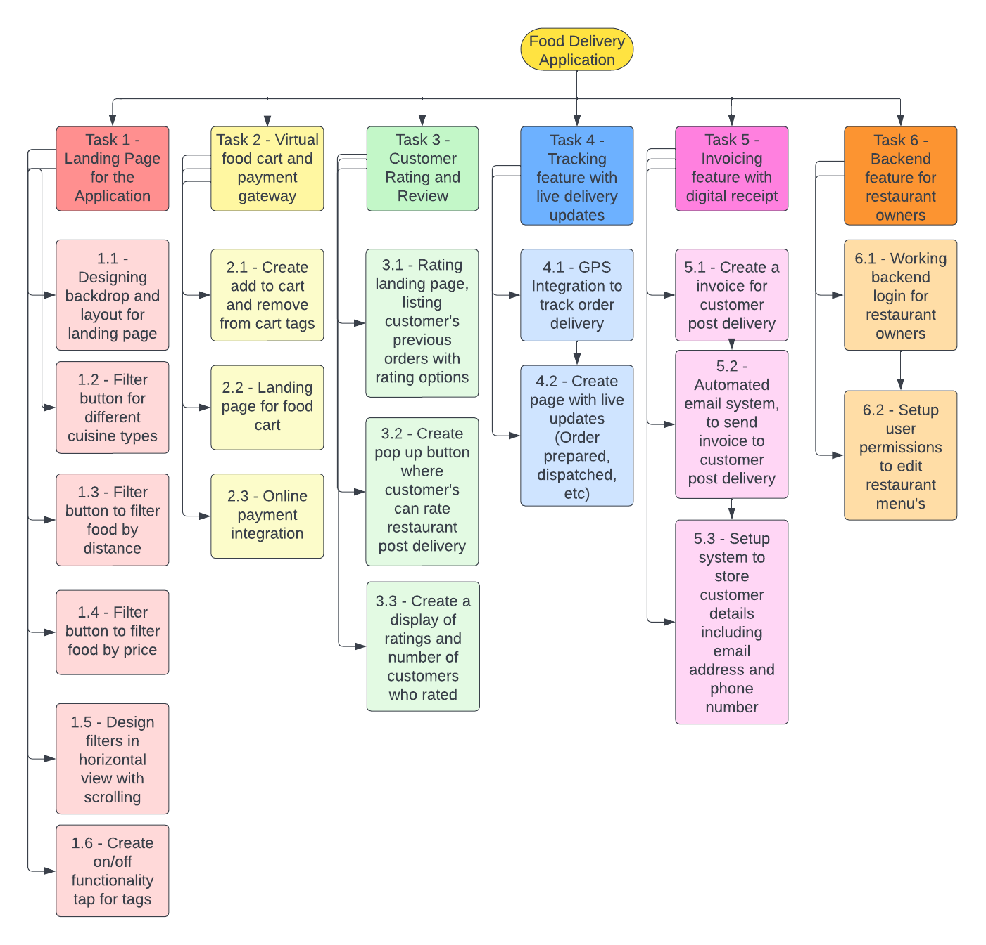
Work BreakDowN Structure(WBS)

Slide 16
Evaluation Baseline
These were the project objectives that were defined beforehand –
Total Project Budget – 142,000
Project Estimated Completion Time – 36 days
Total Project Tasks – 6, Subtasks – 19 tasks
Based on requirements, Developer’s, Programmers and Project Managers were assigned to the project.
For this project we have used the bottom-up approach for cost estimation and assigned budgets to each task and compared it with actual costs.
We have carried out earned value analysis for this project, to see based on the current status of the project what our cost variance, schedule variance and project overview is.

Slide 17
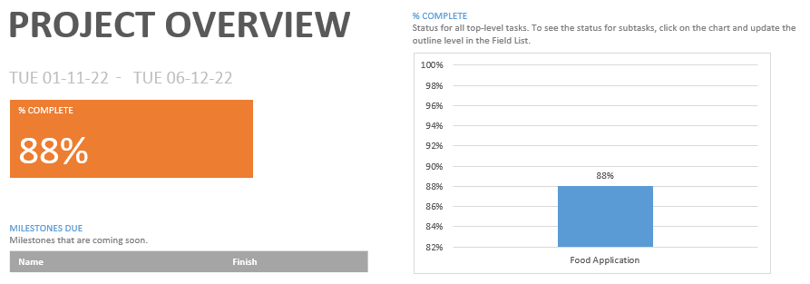
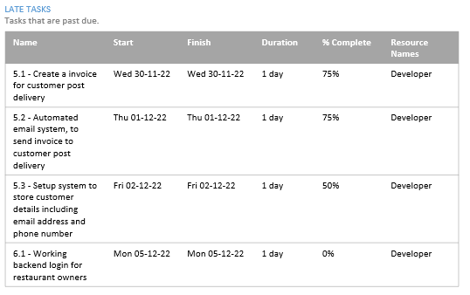
Project Overview

Slide 18
PROJECT OVERVIEW
Currently based on the project’s present status, it is 88% complete.
Our project was supposed to finish by 6th December 2022, but based on the analysis done on 6th December, currently the project has not finished.
In the above slide, we can see that tasks 5 is partially incomplete and 6 is fully incomplete, which shouldn’t be the case. Based on the target set, the project should’ve been completed by now.
The Developer resource has been assigned to these tasks, and majority of that resource is left to be used, we can also note that here.

Slide 19
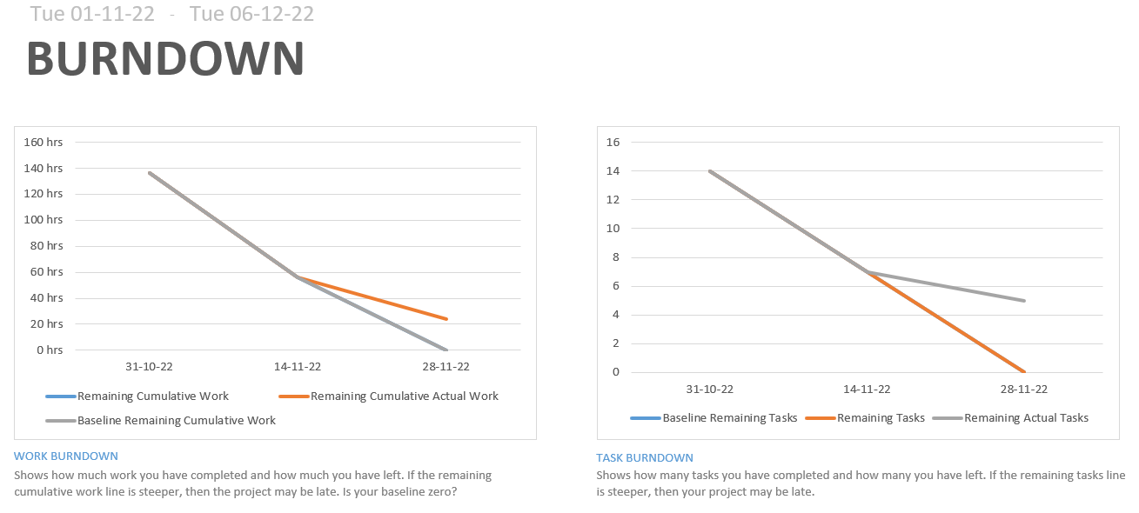
Burndown Chart

Slide 20
Burndown chart analysis
The burndown chart here is generated here is from 1st November 2022 to 6th December 2022.
We can see based on the line chart that based on the baseline given, work should have been finished by now, but we are behind schedule.
The work burndown shows us here that around 20-30 hours of work is remaining still, and the task burndown shows us that more than 4 subtasks are left to complete still.
Based on these details we can solidify further by detail how behind schedule we are.

Slide 21
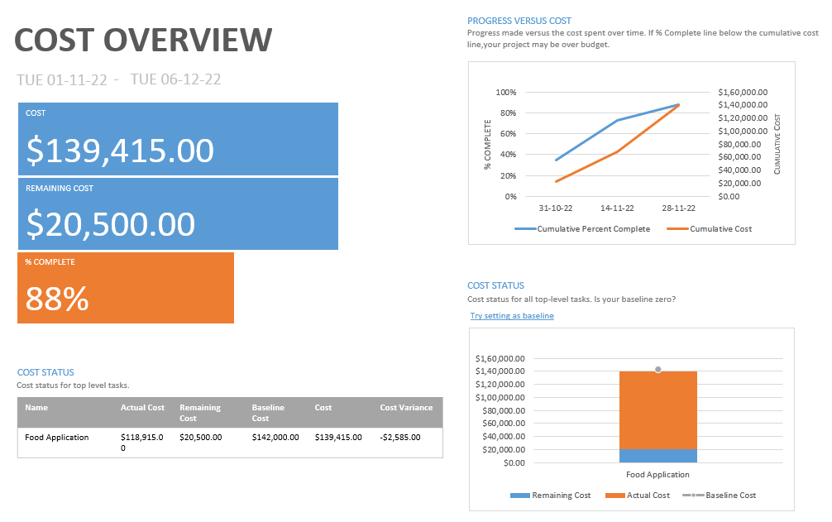
Cost Overview

Slide 22
COST OVERVIEW
Based on the cost overview dashboard, we can see that up to this point, $139,415 has been spent on this project.
Also based on the progress vs cost chart, we can see that the we’ve not completely the project based on the baseline cost defined.
Only 88% of the project has been finished and still to finish the rest, an expense of 20,500 is still left.
So even though currently we are under budget, our project hasn’t finished. So, we will have to allocate new resources to speed up our project completion which will obviously push our project over-budget.
Based on the cost status report, we can see that currently $139,415 has been used up in the project and we are $2585 under budget but are project hasn’t finished completely and an estimated $20,500 are still left.

Slide 23
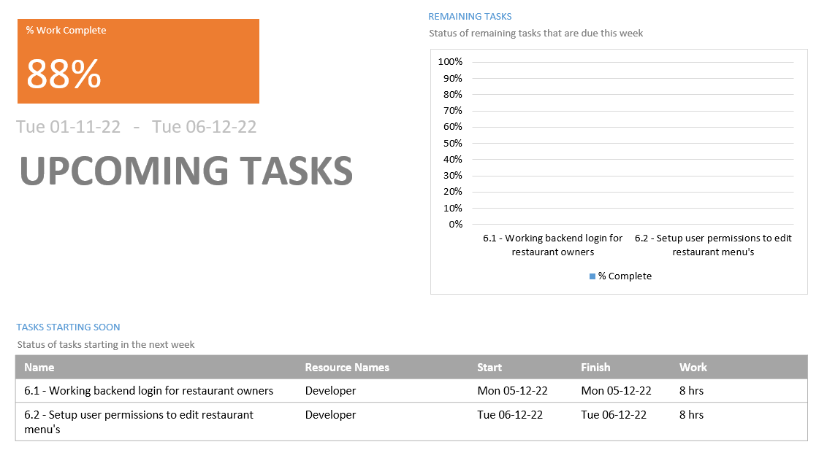
Upcoming tasks for the project

Slide 24
UPCOMING AND COMPLETED TASKS
Here, task 5 is currently in progress, with multiple subtasks completed up to a certain point.
Task 6 has two subtasks and that has not even been started yet. All the tasks in task 6 are 0% complete.
We can see that only the developer has been assigned to these tasks, so our resources are also defined.
We can see the assigned work hours for each subtask here and also the expected start and finish dates.

Slide 25
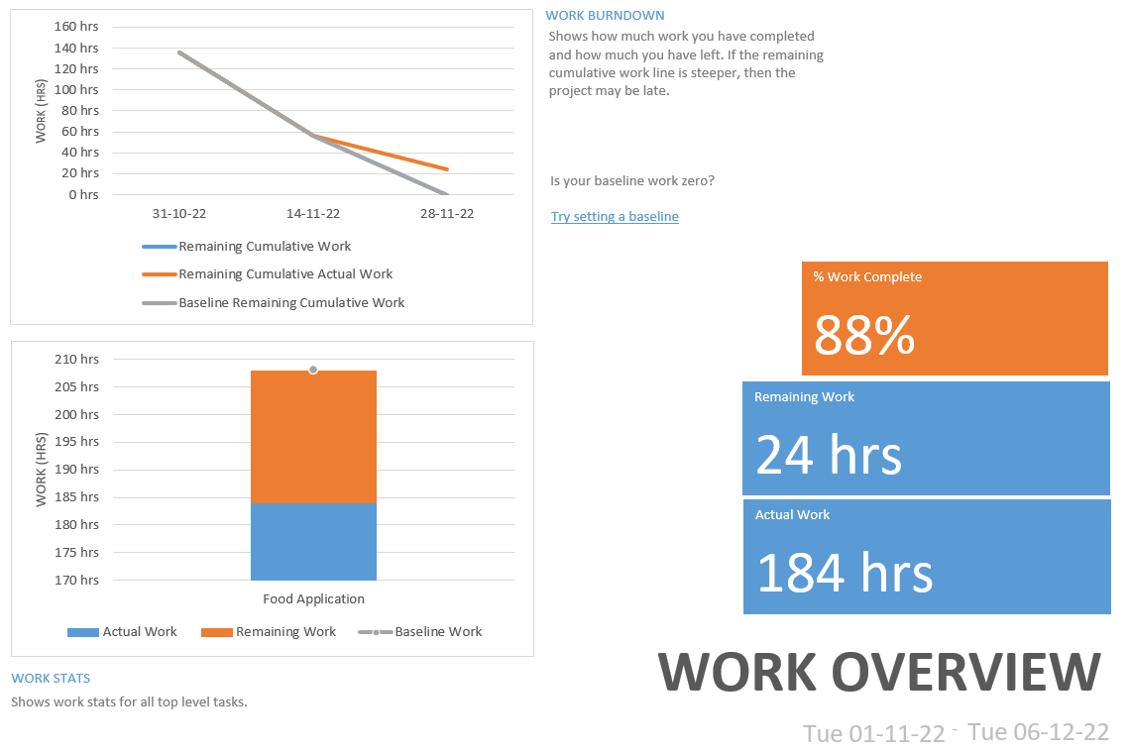
Work Overview

Slide 26
WORK OVERVIEW and burndown
Here based on the work burndown chart we can see the effort of hours that remains in the project.
Up to now 184 hours of work has been completed and 24 hours of work effort remains.
Again, based on the charts created we can see we are behind schedule based on work remaining to be done.

Slide 27
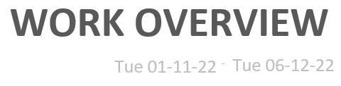
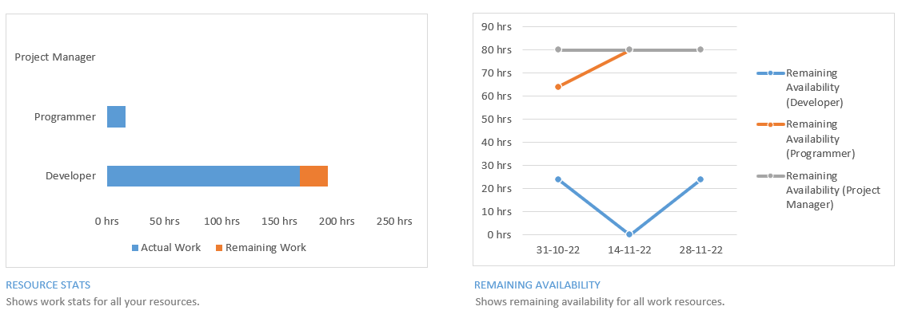
Work overview

Slide 28
WORK OVERVIEW OF RESOURCEs
We can see here that the project manager hasn’t been used much during the project timeline, the programmer has been used slightly but the developer has been used the most.
We can see that the developer hours were underestimated for the project at a certain point, in the middle of the project.
Needing more developers for the project seems to be a continuing issue here.

Slide 29
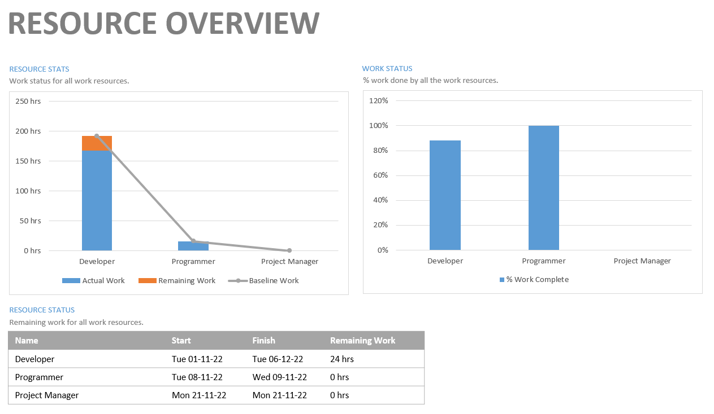
Resource overview

Slide 30
RESOURCE OVERVIEW
Based on this dashboard we can see the hours worked for each resource in this project.
We can see that all the tasks which required the programmer have been completed and project manager hasn’t been used comparatively to other resources.
The developer has the most work left in the project and almost 200 hours of work has already been done by that team.
We can also see the remaining hours for the developer team is 24.

Slide 31
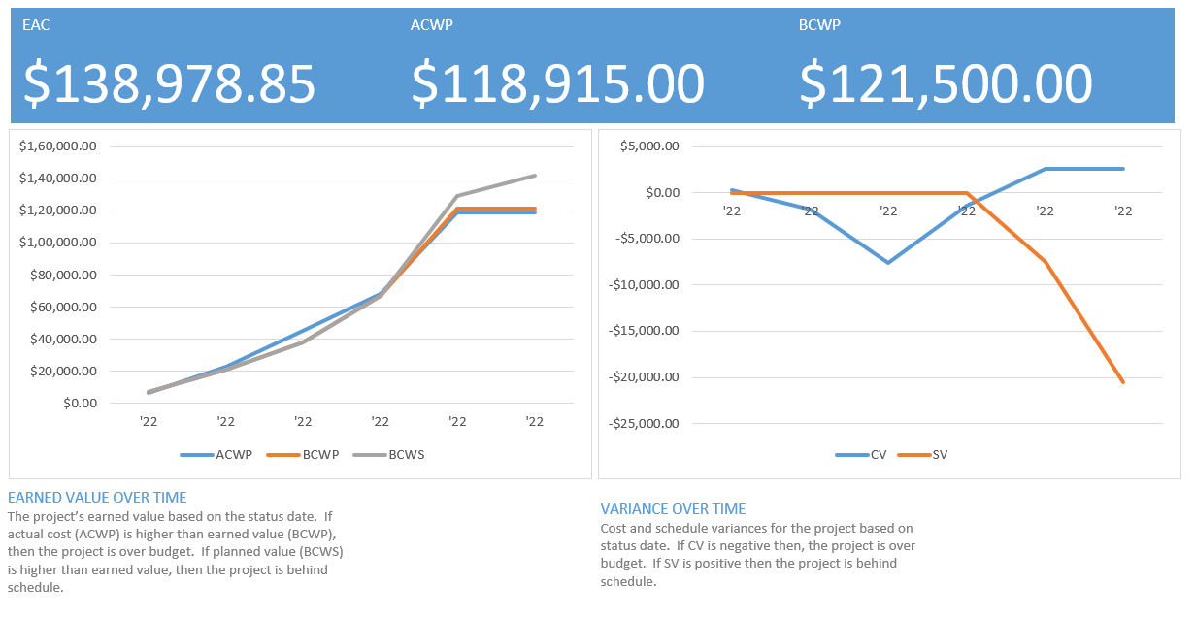
EARNED VALUE REPORT

Slide 32
EARNED VALUE ANALYSIS
Based on the earned value report we can draw the following conclusions:
Here our estimated actual cost at completion is $138,978.85 and our total allocated budget is $142,000. Even though the system here is predicting us to stay under budget till late completion, it cannot be guaranteed that our actual cost will be under budget at completion.
Our actual cost currently is lower than the earned value, meaning that we are currently under budget, but because we’ve passed the project completion date, we are bound to add more resources and go over budget and finish the project late.
Looking at the variance over time chart, we can see that during the middle of our project there were certain tasks which went over budge due to which we have a negative cost variance, and our schedule variance is also negative completely because we couldn’t finish certain tasks on time to meet the end date.

Slide 33
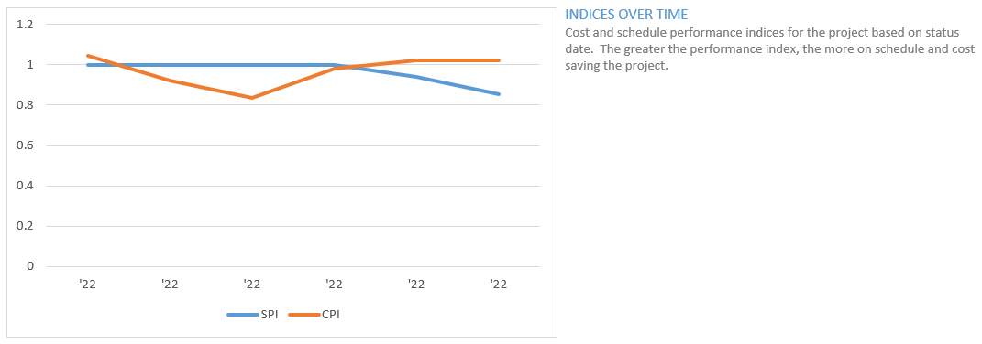
Schedule and cost variance over time
Based on the SPI and CPI spread we can see that we went over budget during the middle of our project but then came back on track during the end, but still we haven’t finished our project.
Our SPI trend shows that we couldn’t finish all the tasks until the required end date and are behind schedule currently in our project.

Slide 34
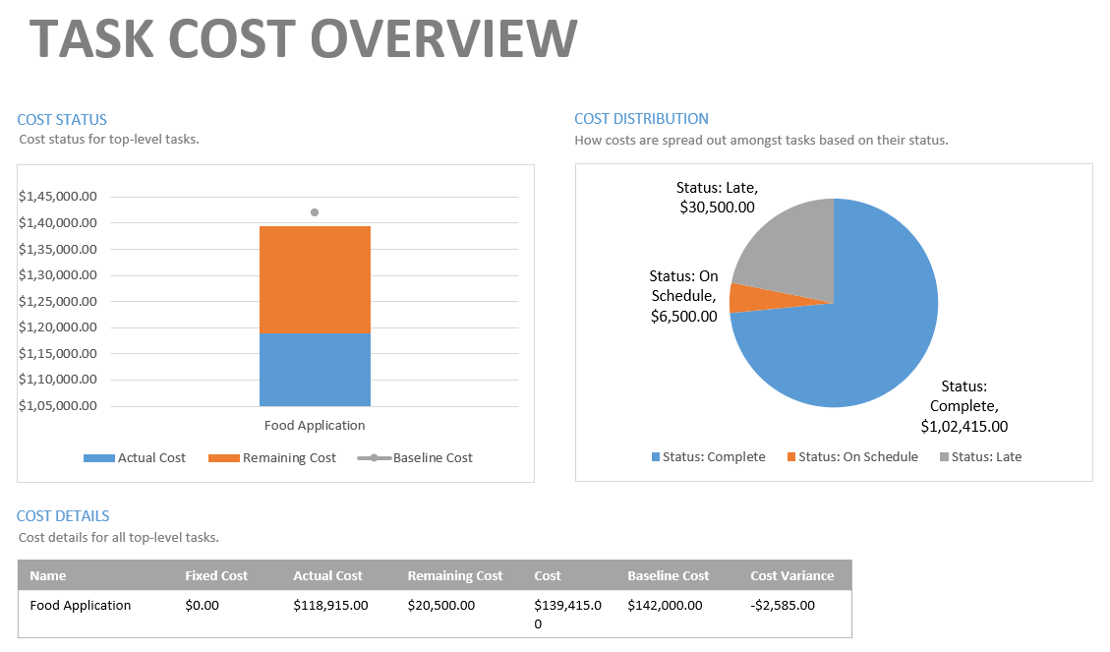
TASK COST OVERVIEW

Slide 35
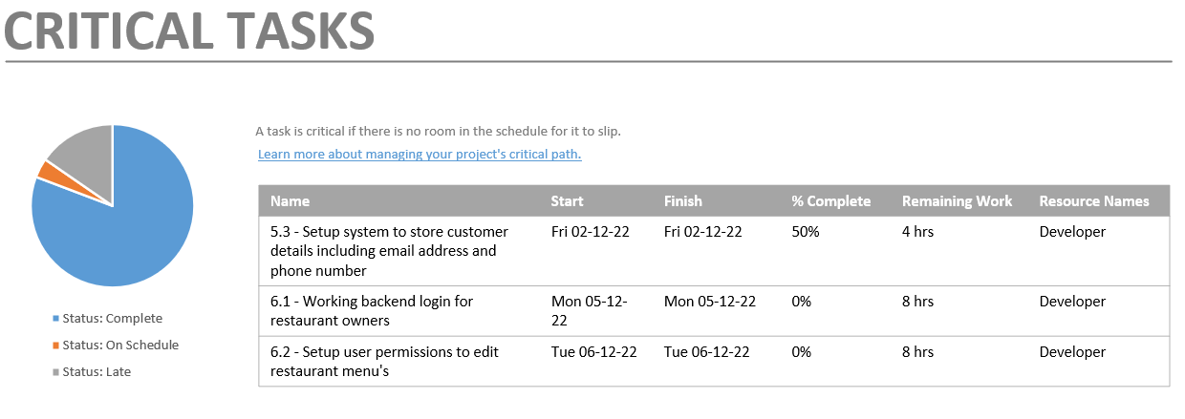
CRITICAL TASKS

Slide 36
TASK COSTS AND CRITICAL TASKS LEFT
Based on the previous two slides, we can see the cost distribution of tasks and can see that around $30,500 worth of tasks are still left to complete.
In order to finish these tasks with the remaining balance, more resources will need to be added.
Tasks 5.3, 6.1 and 6.2 have been defined as the critical tasks here, because those are the ones least completed. These are the ones that need to be focused on the most.
These tasks aren’t even late, these haven’t even been started and are not complete up to needed benchmarks.

Slide 37
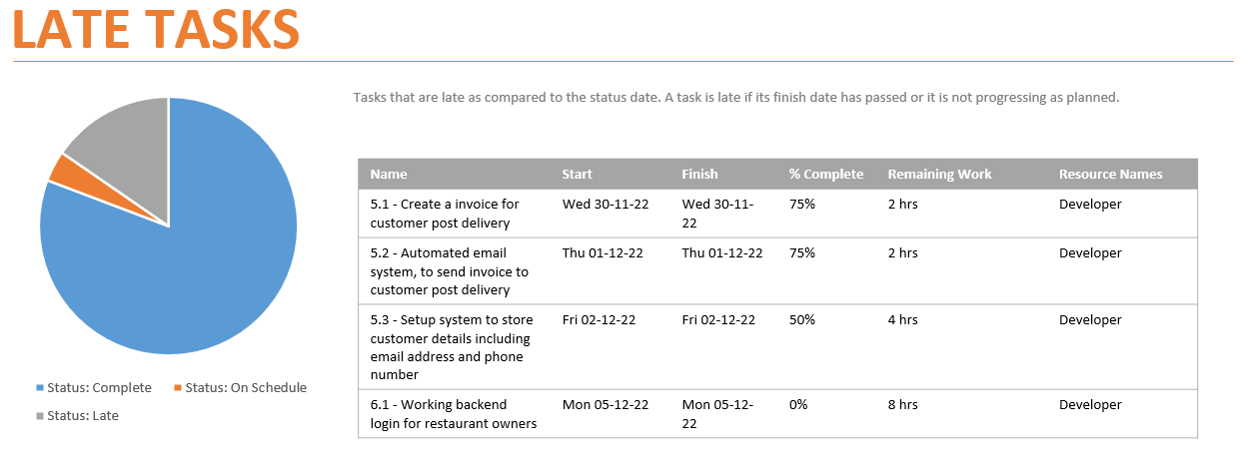
Late tasks
Tasks 5.1, 5.2, 5.3 and 6.1 have been defined as late here, because efforts were put in and tasks were started but now, we’ve reached our finish date.

Slide 38
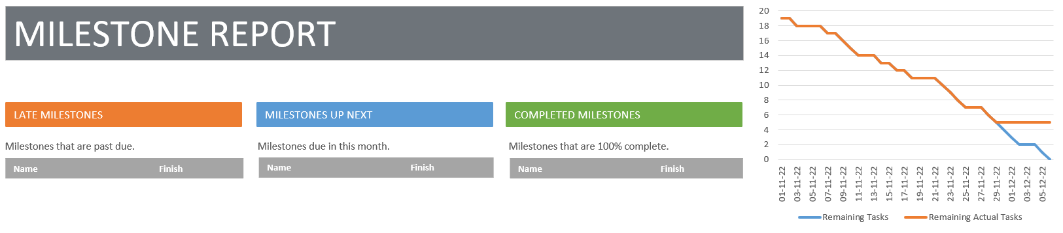
MILESTONE REPORT
Based on the milestone report here, we can see that based on required end date, more than 4 tasks are still left to complete.

Slide 39
CHANGE MANAGEMENT PLAN
Based on the current status of the project and the analysis done, following are the changes that need to be prioritized in order to finish the project as soon as possible.
Priority of change request – Finish tasks 5 and 6 at rapid speed
Resources including budget and developer’s need to be added in order to finish the project asap.
More number of developers need to be hired in order to work separately on tasks 5 and 6 to speed up completion dates.

Slide 40
THANK YOU

